Slide 1
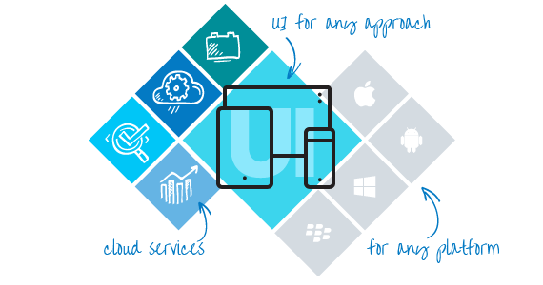

Telerik AppBuilder
Cross-platform mobile development.
Simplified.
Hybrid Mobile Applications
Telerik Software Academy
http://academy.telerik.com

Slide 2
Table of Contents
Telerik Platform
Telerik AppBuilder

Slide 3
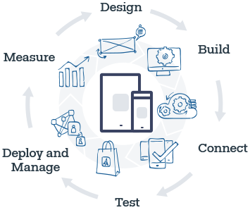
Telerik Platform

Slide 4
Telerik Platform
Telerik AppPrototyper
Telerik AppBuilder
Telerik Backend Services
Telerik Mobile Testing
Telerik AppManager
Telerik Analytics
Telerik AppFeedback

Slide 5
Telerik AppBuilder

Slide 6
Telerik AppBuilder Overview
One environment
IDE of your choice
Simulator
Debugging Tools
Publishing
Deploy
Take care of everything
Cloud Based

Slide 7

Ice Choices
In-Browser Client
Windows Client
Visual Studio Extension
Sublime Text Package
Command-Line Interface

Slide 8

Telerik AppBuilder Overview 2
Live Sync on all connected devices
Integrated version control
Realistic simulation
Powerful debugging
iOS without provisioning
Publishing

Slide 9

Simulator

Slide 10

Simulator
Web and Desktop
LiveSync
Settings
Orientation
OS
Navigator
Accelerator
Connection
Etc.

Slide 11
Mobile Applications
http://academy.telerik.com

